Slide 1
FACE MASK DETECTION
USING CNN
Deep Learning Mini Project | CS722T2C
PROJECT TEAM
GUIDED BY
Amaresha K • 4SF23CS016
Aryan NB • 4SF23CS036
Ganesh Gond • 4SF23CS067
Ms. Shiji Abraham
Assistant Professor, Department of CSE
Sahyadri College of Engineering & Management

Slide 2
Project Overview
02
A concise view of the problem, solution and outcome
PROBLEM
SOLUTION
OUTCOME
Manual monitoring of mask compliance is labour intensive, inconsistent and difficult to scale across crowded public spaces.
A computer-vision pipeline detects faces and classifies mask status from images or live video.
The report records 98.2% accuracy with strong precision, recall and F1-score.
IMAGE INPUT
FACE DETECTION
CNN CLASSIFICATION
REAL-TIME OUTPUT
Supports with-mask, without-mask and optionally incorrectly-worn-mask classification.
Designed for practical entry-point, surveillance and public-safety use cases.
Built with open-source Python, TensorFlow/Keras and OpenCV technologies.
FACE MASK DETECTION USING CNN • SAHYADRI COLLEGE OF ENGINEERING & MANAGEMENT

Slide 3
Motivation & Need
03
Why automation is useful for mask-compliance monitoring
01 SCALE
02 CONSISTENCY
03 CONTACTLESS OPERATION
Manual checking becomes difficult when many people must be monitored simultaneously across multiple locations.
An automated visual system can apply the same classification process continuously rather than relying on repeated manual checks.
Computer vision can reduce direct interaction during compliance monitoring and can integrate with existing infrastructure.
FACE MASK DETECTION USING CNN • SAHYADRI COLLEGE OF ENGINEERING & MANAGEMENT

Slide 4
Problem Statement & Objectives
04
What the project is designed to achieve
PROBLEM STATEMENT
PROJECT AIM
There is a need for an automated visual monitoring system that can process video feeds and flag individuals who are not wearing a mask or are wearing it incorrectly.
Design and implement a CNN-based system that detects faces and classifies mask status in real time with sufficient accuracy and low latency.
Collect and preprocess a labelled face-mask dataset.
Train a CNN / transfer-learning classifier.
Integrate face detection with the trained classifier.
Enable real-time detection through OpenCV.
Evaluate accuracy, precision, recall, F1-score and confusion matrix.
FACE MASK DETECTION USING CNN • SAHYADRI COLLEGE OF ENGINEERING & MANAGEMENT

Slide 5
Literature Survey
05
Selected approaches discussed in the report
TRANSFER LEARNING
REAL-TIME DETECTION
OBJECT DETECTION
ResNet50 and InceptionV3 have been explored for mask classification.
CNN, SSD and MobileNetV2 combinations target practical real-time systems.
RetinaFace Mask and YOLOv5 target fast detection, including crowded scenes.
DATASETS
LIGHTWEIGHT MODELS
PROJECT DIRECTION
RMFRD, SMFRD and other public datasets support masked/unmasked face learning.
The report highlights MobileNetV2 because of its low computational footprint.
A two-stage approach is used: face localization followed by mask-status classification.
Key takeaway from the survey: practical systems increasingly combine fast face detection with lightweight deep-learning classification.
FACE MASK DETECTION USING CNN • SAHYADRI COLLEGE OF ENGINEERING & MANAGEMENT

Slide 6
Proposed System Workflow
06
End-to-end process used by the project
01 INPUT
02 FACE LOCALIZATION
03 PREPROCESSING
04 CLASSIFICATION
05 RESULT
Image / webcam frame
Haar Cascade / MTCNN
Crop, resize, normalize
CNN / transfer learning
Label + confidence + box
WITH MASK
WITHOUT MASK
FACE MASK DETECTION USING CNN • SAHYADRI COLLEGE OF ENGINEERING & MANAGEMENT

Slide 7
Dataset & Preprocessing
07
Preparing consistent inputs for supervised learning
DATA SOURCE
DATA SPLIT
PREPROCESSING
The public face-mask datasets such as Kaggle Face Mask Detection, Masked Face-Net and RMFD.
Approximately 80% training, 10% validation and 10% testing, with class balance maintained or addressed.
Images are resized, normalized to [0,1] and augmented using rotation, zoom, horizontal flip and shear.
RAW IMAGE
RESIZE
NORMALIZE
AUGMENT
MODEL INPUT
FACE MASK DETECTION USING CNN • SAHYADRI COLLEGE OF ENGINEERING & MANAGEMENT

Slide 8
Technology Stack
08
Tools and technologies used in implementation
Python 3.x
TensorFlow / Keras
OpenCV
Core programming language
Deep-learning framework
Computer vision + video processing
Haar Cascade / MTCNN
MobileNetV2
NumPy / Pandas
Face localization
Transfer-learning base model
Data processing
scikit-learn
Jupyter / Colab / VS Code
Git / GitHub
Evaluation metrics
Development
Version control
FACE MASK DETECTION USING CNN • SAHYADRI COLLEGE OF ENGINEERING & MANAGEMENT

Slide 9
Functional & Non-Functional Requirements
09
FUNCTIONAL
NON-FUNCTIONAL
• Accept image or live webcam/video input
• Detect and localize human faces
• Classify mask status
• Display labels and bounding boxes
• Report compliant / non-compliant counts
• Near-real-time performance target: ≥15–20 FPS
• Test accuracy target: ≥95%
• Clear, interpretable visual output
• Support standard PCs and edge devices
• Open-source and cross-platform implementation
FACE MASK DETECTION USING CNN • SAHYADRI COLLEGE OF ENGINEERING & MANAGEMENT

Slide 10
Results & Evaluation
10
Performance reported on the held-out test set
98.2%
97.8%
98.0%
97.9%
Accuracy
Precision
Recall
F1-score
TRAINING OBSERVATION
REAL-TIME OBSERVATION
The training and validation accuracy/loss curves indicated convergence without significant overfitting.
Webcam testing showed faces being detected and classified with bounding boxes and labels updating smoothly across frames.
FACE MASK DETECTION USING CNN • SAHYADRI COLLEGE OF ENGINEERING & MANAGEMENT

Slide 11
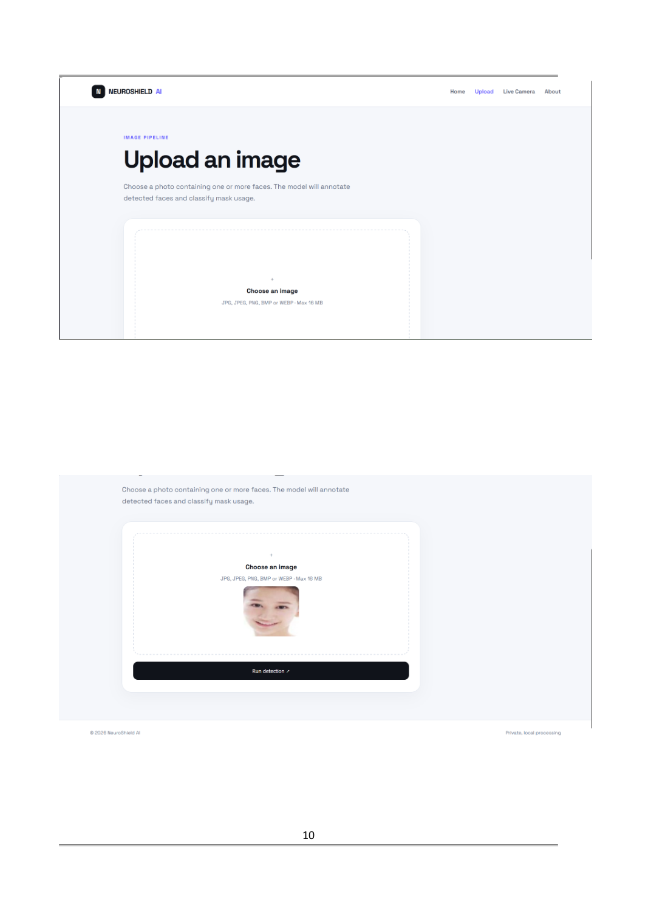
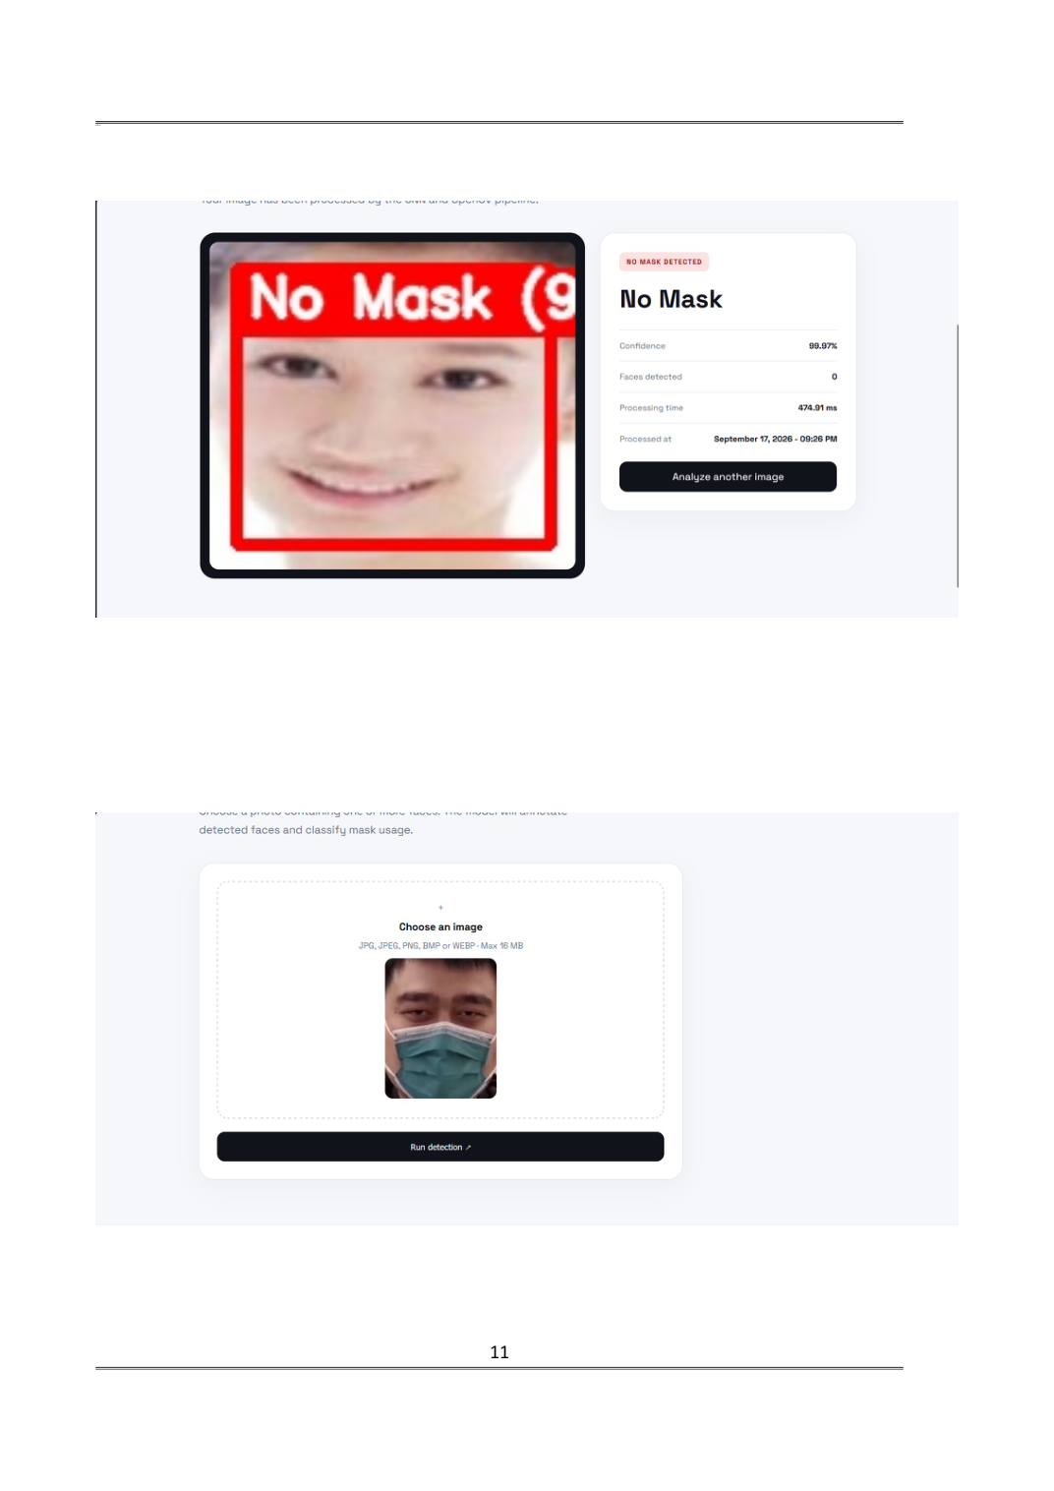
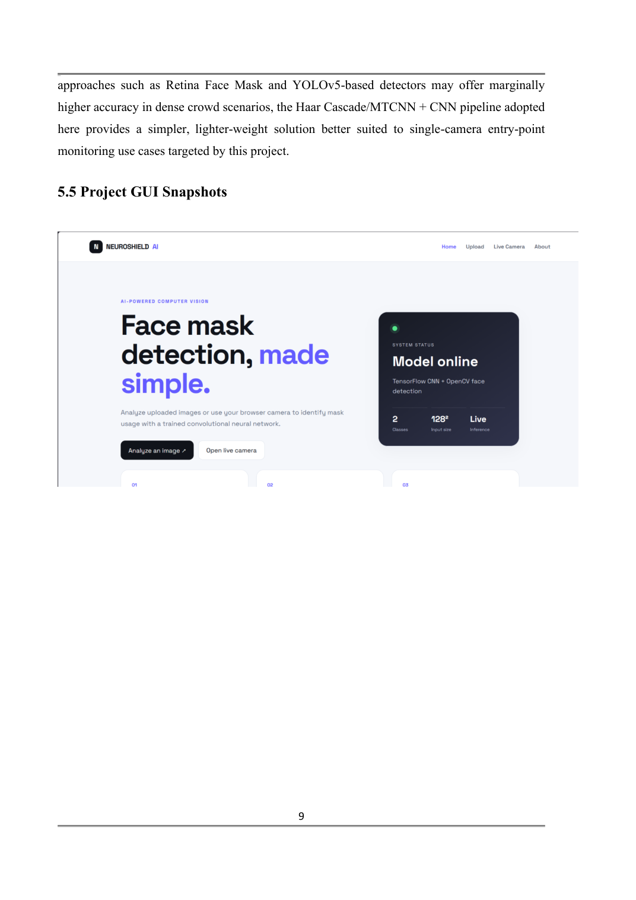
s
Application Interface
11
Home / Model Online
Image Upload
No-Mask Detection
MASK / NO-MASK ANALYSIS
FACE MASK DETECTION USING CNN • SAHYADRI COLLEGE OF ENGINEERING & MANAGEMENT

Slide 12
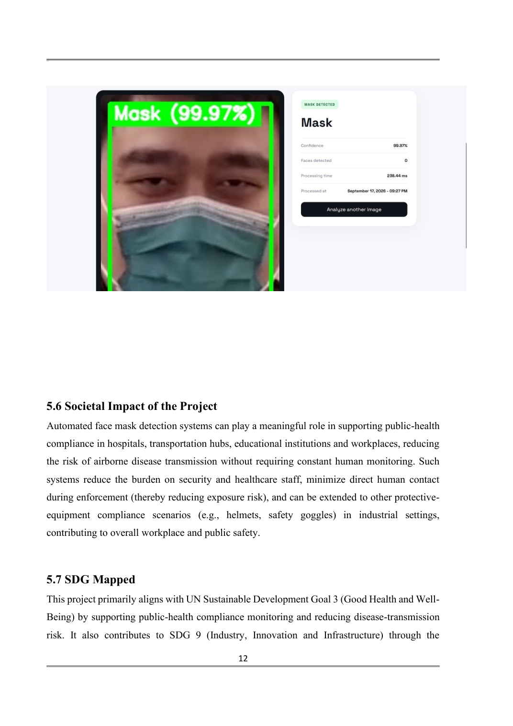
Detection Output
12
MASK DETECTED
NO MASK DETECTED
FACE MASK DETECTION USING CNN • SAHYADRI COLLEGE OF ENGINEERING & MANAGEMENT

Slide 13
Societal Impact & SDG Alignment
13
SOCIETAL IMPACT
EXTENSION
Supports public-health compliance in hospitals, transportation hubs, educational institutions and workplaces while reducing the burden of constant manual monitoring.
The same computer-vision approach can support other safety-compliance scenarios, including helmets and safety goggles.
SDG 3
SDG 9
SDG 11
Good Health & Well-Being
Public-health compliance and reduced transmission risk.
Industry, Innovation & Infrastructure
AI-based automation for public-safety infrastructure.
Sustainable Cities & Communities
Smarter, safer public spaces using existing infrastructure.
FACE MASK DETECTION USING CNN • SAHYADRI COLLEGE OF ENGINEERING & MANAGEMENT

Slide 14
Conclusion & Future Scope
14
Where the project stands and how it can evolve
CONCLUSION
FUTURE SCOPE
The project implements a CNN-based face-mask detection system for static images and real-time video. The report demonstrates high classification performance while targeting low-latency practical deployment.
• Multi-camera and multi-person tracking
• Centralized dashboard reporting
• Integration with facial recognition and temperature screening
• Model quantization / pruning for edge devices
• Larger and more diverse datasets
FACE MASK DETECTION USING CNN • SAHYADRI COLLEGE OF ENGINEERING & MANAGEMENT

Slide 15
References
15
[1] M. Loey, G. Manogaran, M. H. N. Taha, and N. E. M. Khalifa, "A hybrid deep transfer learning model with machine learning methods for face mask detection in the era of the COVID-19 pandemic," Measurement, vol. 167, 2021.
[2] S. V. Militante and N. V. Dionisio, "Real-Time Facemask Recognition with Alarm System
using Deep Learning," in Proc. ICSGRC, 2020.
[3] X. Jiang, T. Gao, Z. Zhu, and Y. Zhao, "Retina Face Mask: A Face Mask Detector," arXiv
preprint arXiv:2005.03950, 2020.
[4] B. Qin and D. Li, "Identifying Facemask-Wearing Condition Using Image Super-Resolution with Classification Network to Prevent COVID-19," Sensors, vol. 20, no. 18, 2020.
[5] G. J. Chowdary, N. S. Punn, S. K. Sonbhadra, and S. Agarwal, "Face Mask Detection Using Transfer Learning of InceptionV3," in Proc. Big Data Analytics (BDA), 2020.
[6] P. Nagrath, R. Jain, A. Madan, R. Arora, P. Kataria, and J. Hemanth, "SSDMNV2: A real time DNN-based face mask detection system using single shot multibox detector and MobileNetV2," Sustainable Cities and Society, vol. 66, 2021.
[7] A. Das, M. W. Ansari, and R. Basak, "COVID-19 Face Mask Detection Using TensorFlow, Keras and OpenCV," in Proc. IEEE INDICON, 2020.
[8] S. Sethi, M. Kathuria, and T. Kaushik, "Face Mask Detection Using Deep Learning: An Approach to Reduce Risk of Coronavirus Spread," Journal of Biomedical Informatics, vol. 120, 2021.
[9] Z. Wang et al., "Masked Face Recognition Dataset and Application," arXiv preprint arXiv:2003.09093, 2020.
[10] S. Bhandary and D. Nagaraj, "Deep Learning based Face Mask Detection Using YOLOv5," in Proc. ICACCS, 2021.
FACE MASK DETECTION USING CNN • SAHYADRI COLLEGE OF ENGINEERING & MANAGEMENT

Slide 16
THANK YOU

